Slide 1

Report Writing & Referencing
It’s easier than you think!

Slide 2

Tell me
Who likes writing reports?
Who likes referencing?

Slide 3
What are learning?
Report Structure
Academic Reports vs. Technical Reports
Using Images
Plagiarism!
Referencing
General Advice
Activities
Questions

Slide 4

Report Structure
Cover Pages

Slide 5

Report Structure
Abstract/Executive Summary

Slide 6
Report Structure
Contents Page

Slide 7
Report Structure
Introduction

Slide 8
Report Structure
The body – Methods/Results/Discussion

Slide 9
Report Structure
Conclusion & Recommendations

Slide 10
Report Structure
References

Slide 11
Report Structure
Appendices/Appendix

Slide 12
Academic Reports vs. Technical Reports

Slide 13
Using Images
Pictures
Graphs
Examples

Slide 14
Plagiarism
And how to avoid it!

Slide 15
Referencing - Types
APA 6/7
MLA
Chicago/Turabian
IEEE

Slide 16
Referencing – APA7
Reference List

Slide 17
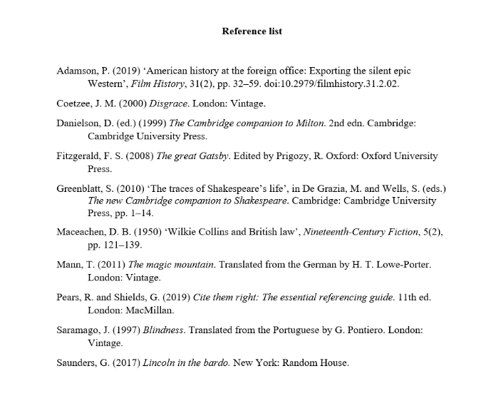
(Caulfield, 2020)

Slide 18
Referencing APA7
In-text Referencing

Slide 19
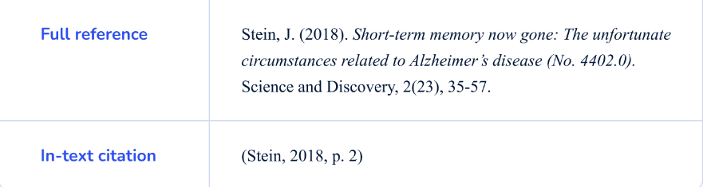
(Flores, 2023)

Slide 20
General Advice for Report Writing

Slide 21
What are we doing next?
Create a report template
Referencing practice

Slide 22

Questions

Slide 23
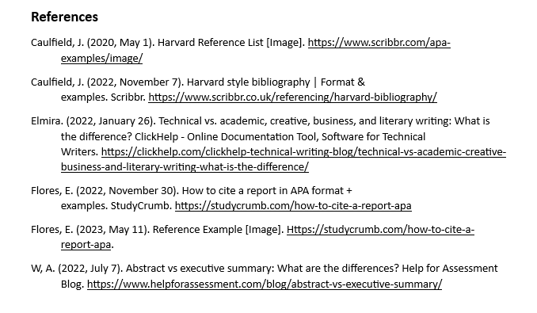
References

